Slide 1
Hoppin’ Brew Social
CS 687 Team Project
Caleb Simmons
Michael Grenon
James Glass

Slide 2
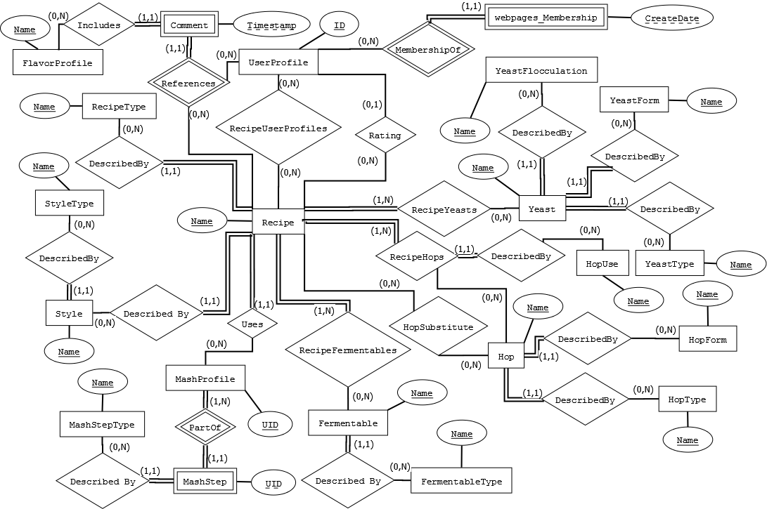
Logical Design - Overall

Slide 3
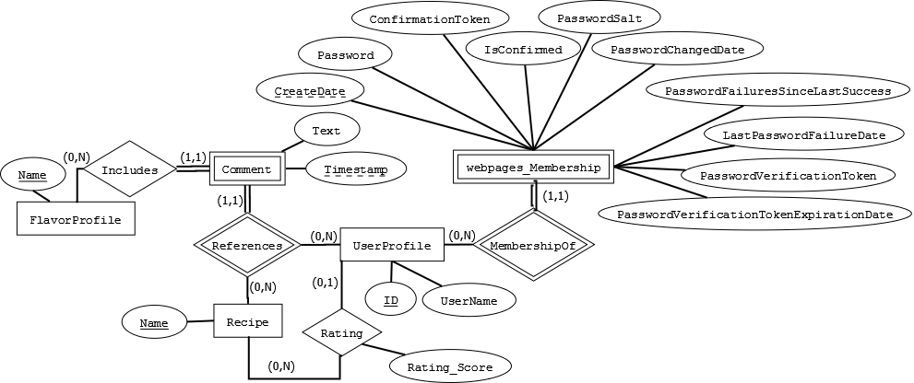
Logical Design – Users, Comments, & Ratings

Slide 4
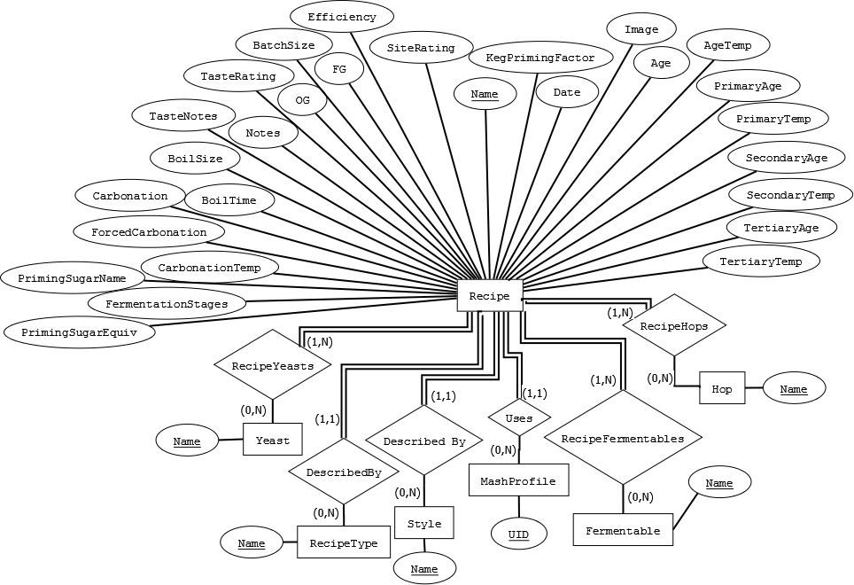
Logical Design – Recipe

Slide 5
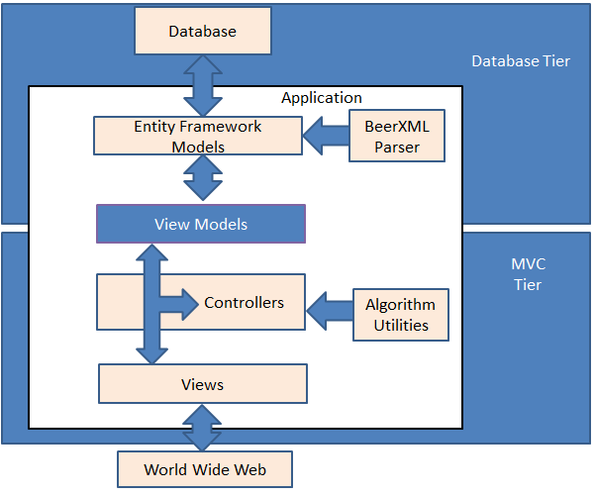
Application Architecture

Slide 6
Questions?

Slide 7
Backup (Logical Design)

Slide 8
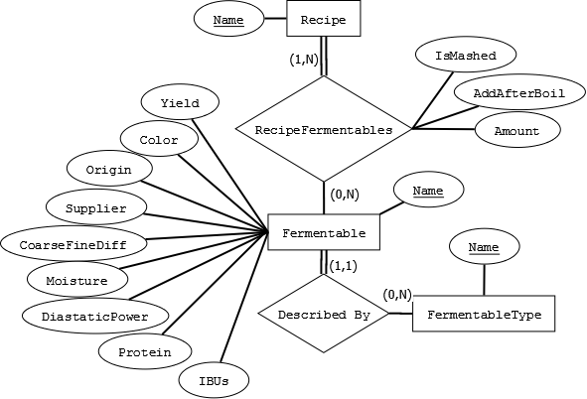
Logical Design - Fermentables

Slide 9
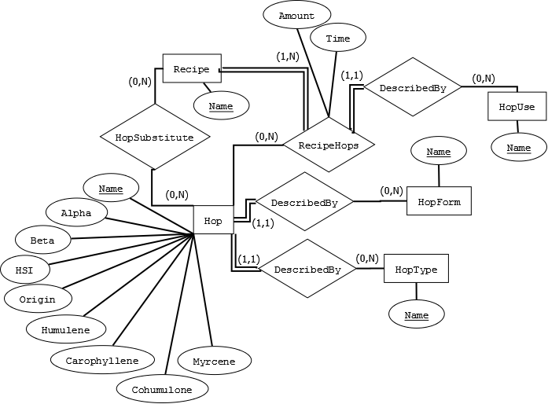
Logical Design – Hops

Slide 10
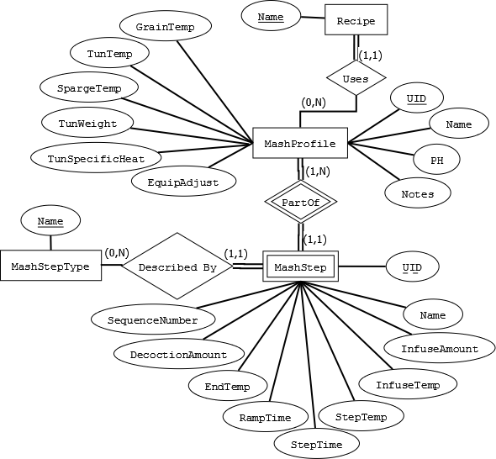
Logical Design – Mash Profile

Slide 11
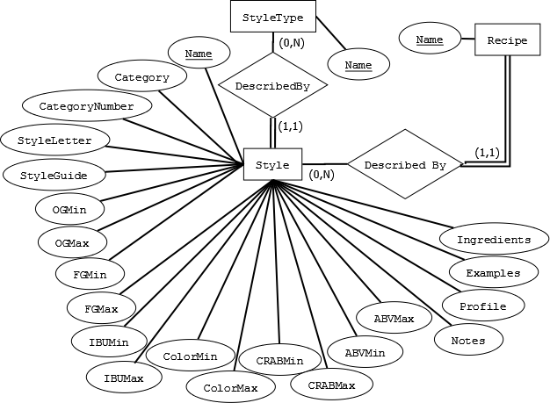
Logical Design - Style

Slide 12
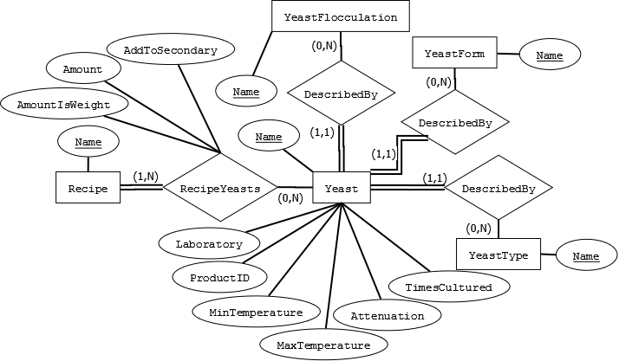
Logical Design - Yeast

Slide 13
Backup (Web UI)

Slide 14
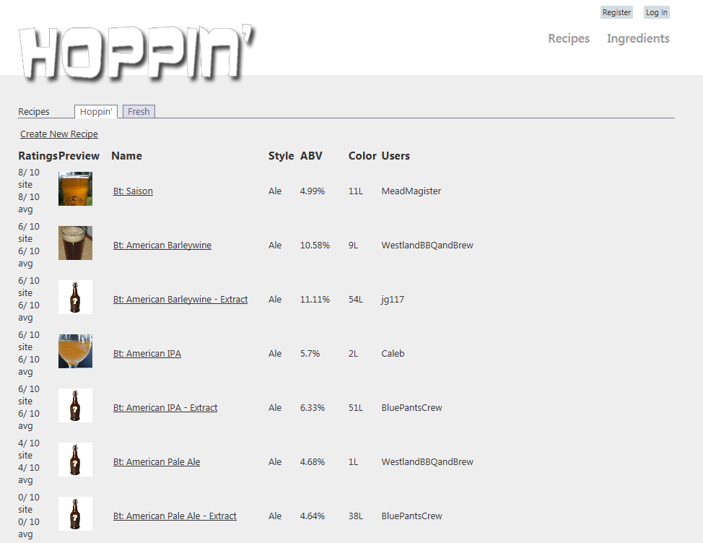
Web UI - Recipe List Page

Slide 15
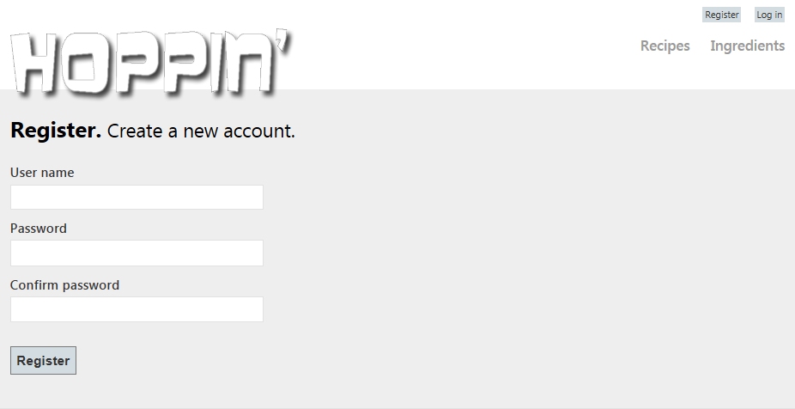
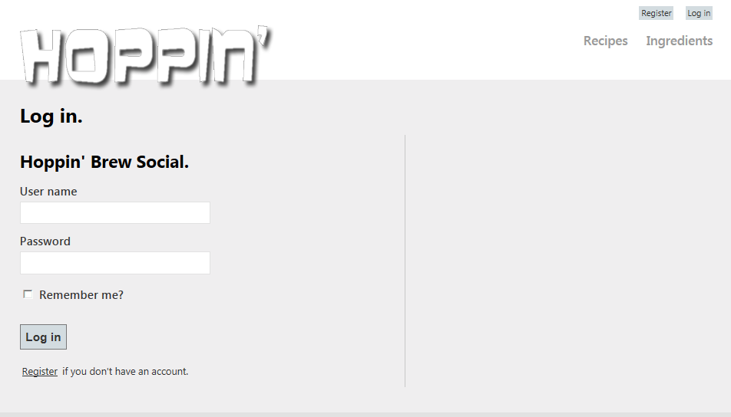
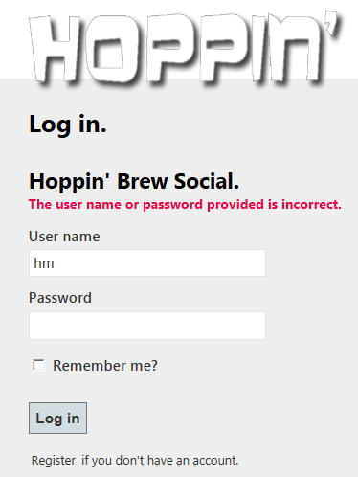
Web UI – User Registration and Login

Slide 16
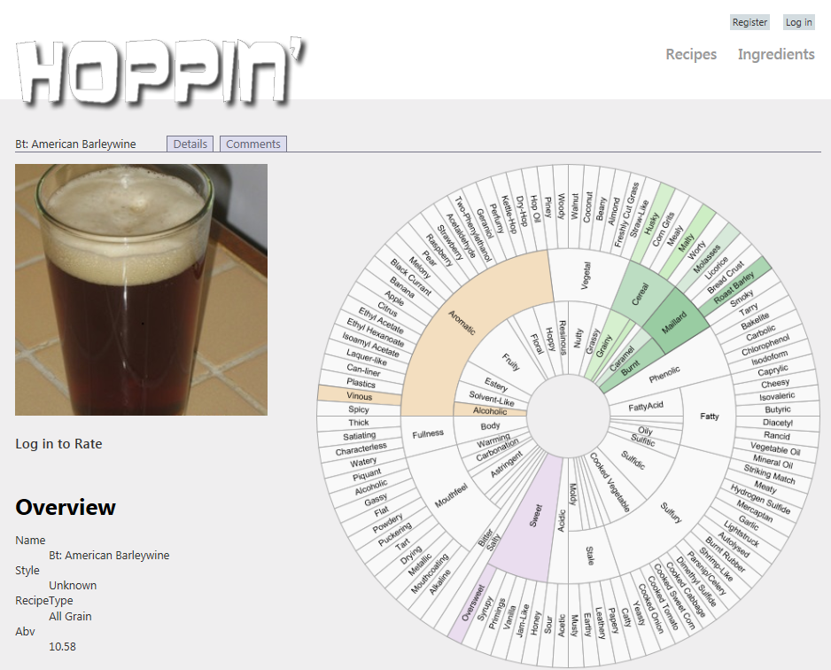
Web UI – Recipe Details

Slide 17
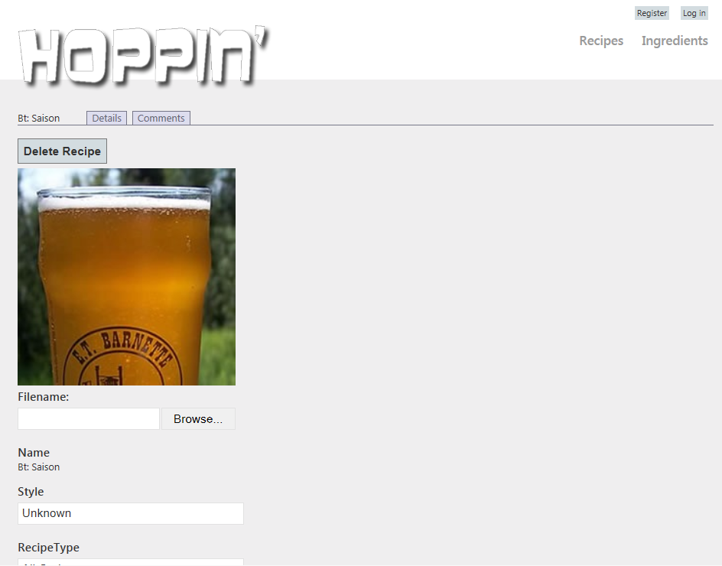
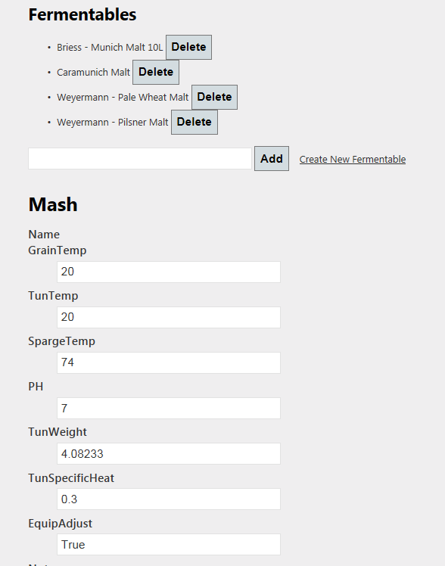
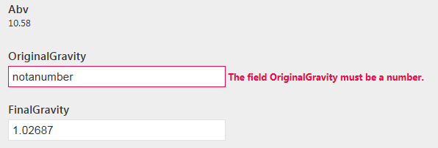
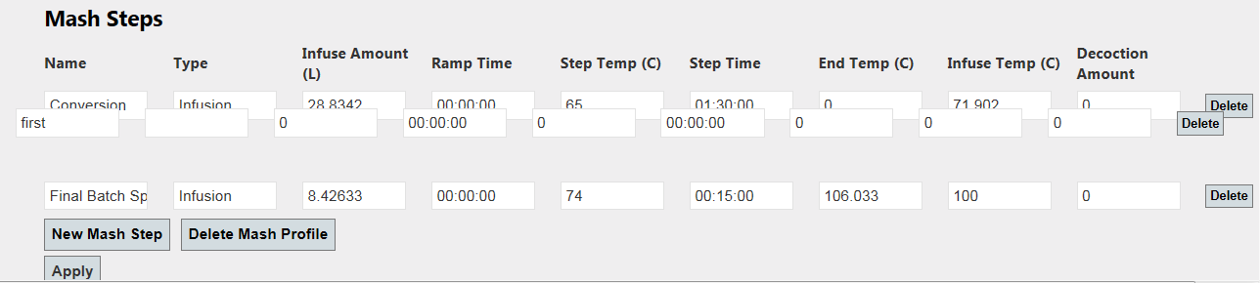
Web UI – Edit Recipe

Slide 18
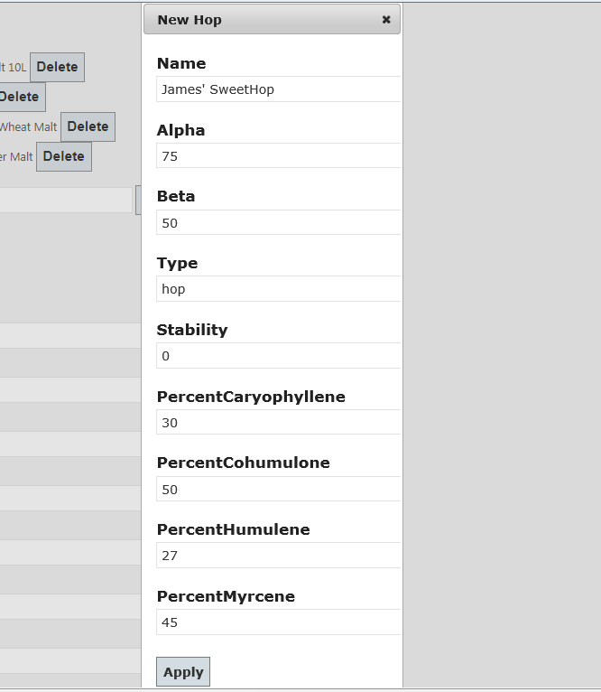
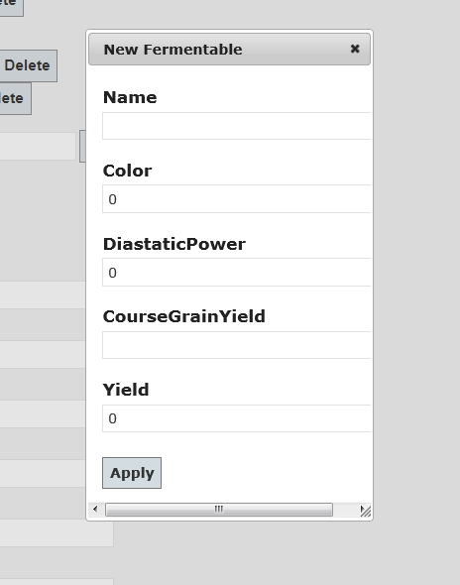
Web UI – Add Hop/Fermentable

Slide 19
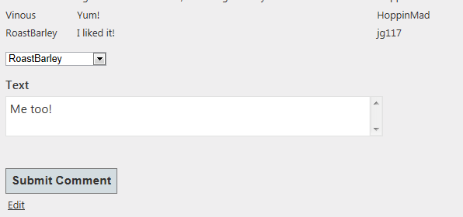
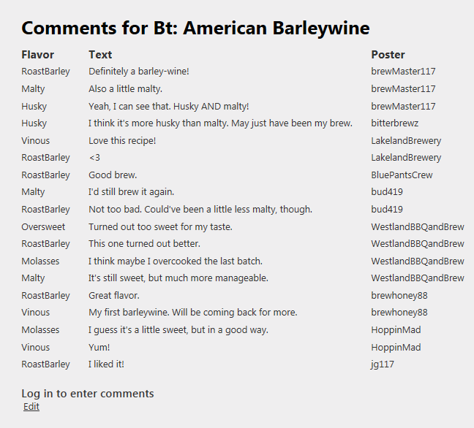
Web UI – Recipe Comments

Slide 20
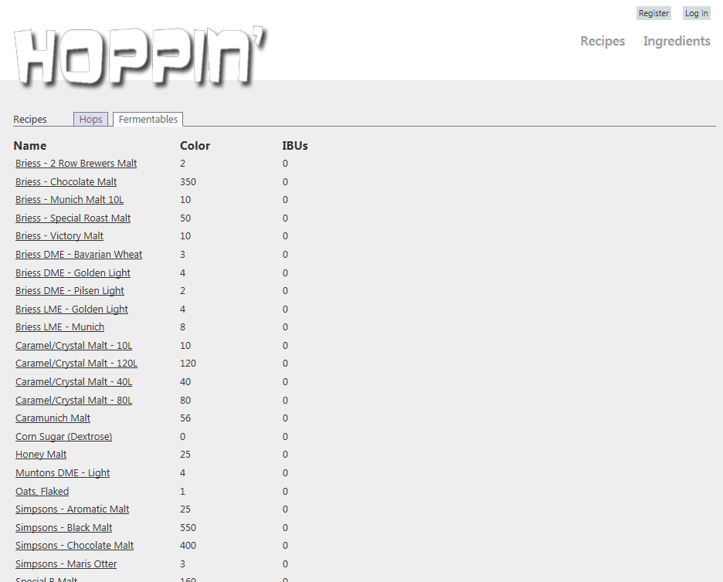
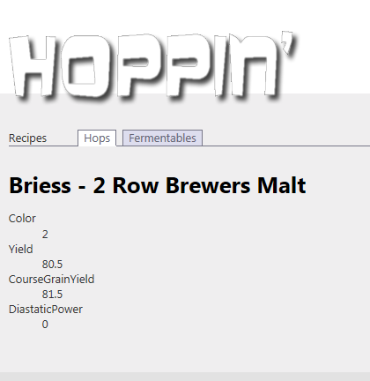
Web UI – Ingredients: Fermentables

Slide 21
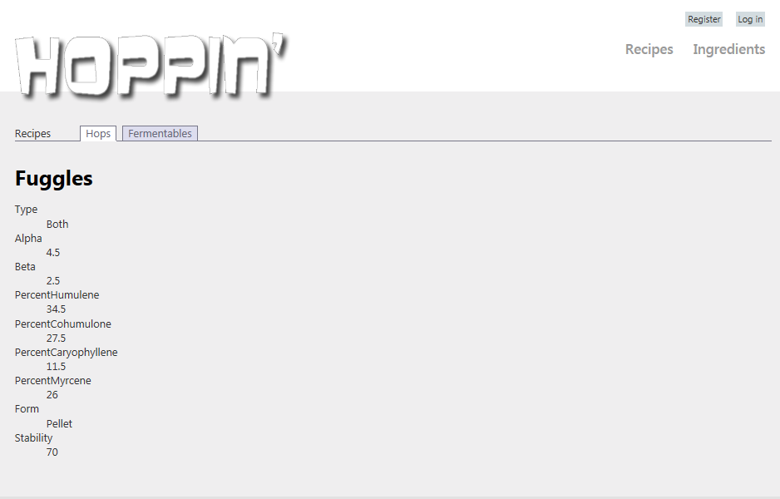
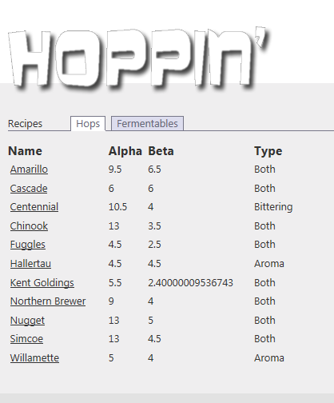
Web UI – Ingredients: Hops

Slide 22
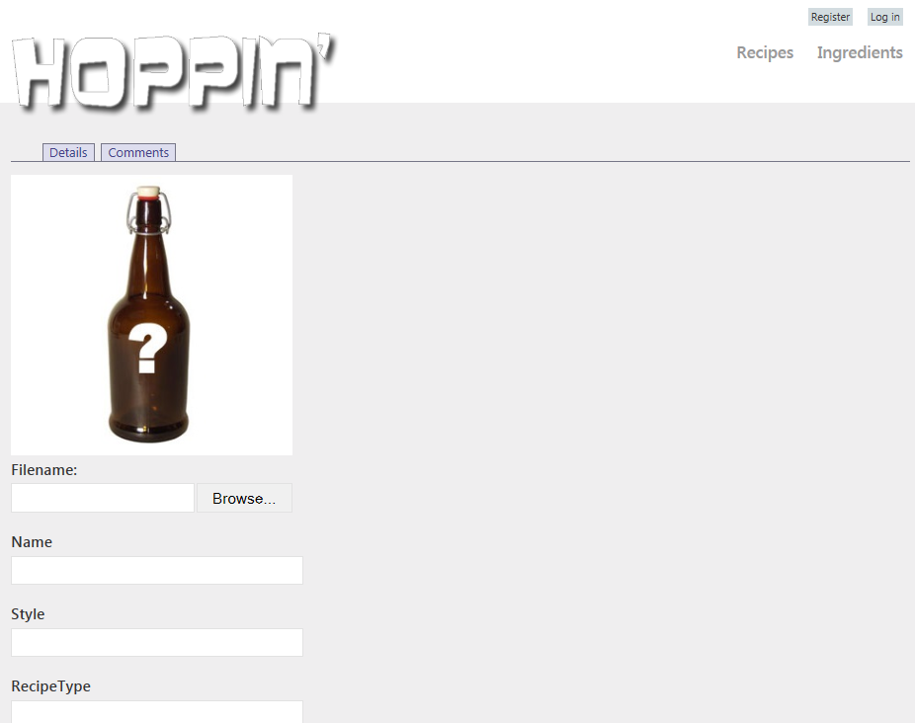
Web UI – Create Recipe

